Slide 1
Disclaimer
This presentation is guidance and not binding on ONRR. It does not provide legal advice and should not be construed as stating ONRR’s legal interpretation or position. Any reliance on this presentation does not limit ONRR in its compliance activities or in the appealable decisions and orders it may issue.

Slide 2
Basic OGOR Reporting ONRR-4054 Oil and Gas Operations Report (OGOR)

Slide 3
Objectives
What ONRR does with the submitted OGOR?
Understand the parts of the OGOR
Header
OGOR-A
OGOR-B
OGOR-C
Learn how to create a new OGOR
Understand required fields
Understand validation
Learn how to print and copy an existing OGOR
NOTE: Reference materials available at ONRR.gov (Minerals Production Reporter Handbook)

Slide 4
ONRR’S System Interface
Reference Data
Reports
to Operators
via the Internet
Operations
Reports
From
Operators
Royalty Reports from Payors
Confirmation
& Missing Reports
to Operators
via the Internet
Production Reporting
Error
Correction
ONRR
Monthly Production
Reports to States / Tribes / BIA
Lease, Well/ANCR & FMP Information
Audit Management and
Compliance
Management
Onshore OGOR
Lease & Well Information
BSEE
Regional
Offices
BLM Service Center
Management
Reports
BLM INSPECTION OFFICES

Slide 5
OGOR Overview
Form ONRR-4054
Oil and Gas Operations Report
Header (Report) Page
OGOR-A: Production Volumes by Well
OGOR-B: Production Volume Dispositions
OGOR-C: Oil Inventory and Sales

Slide 6
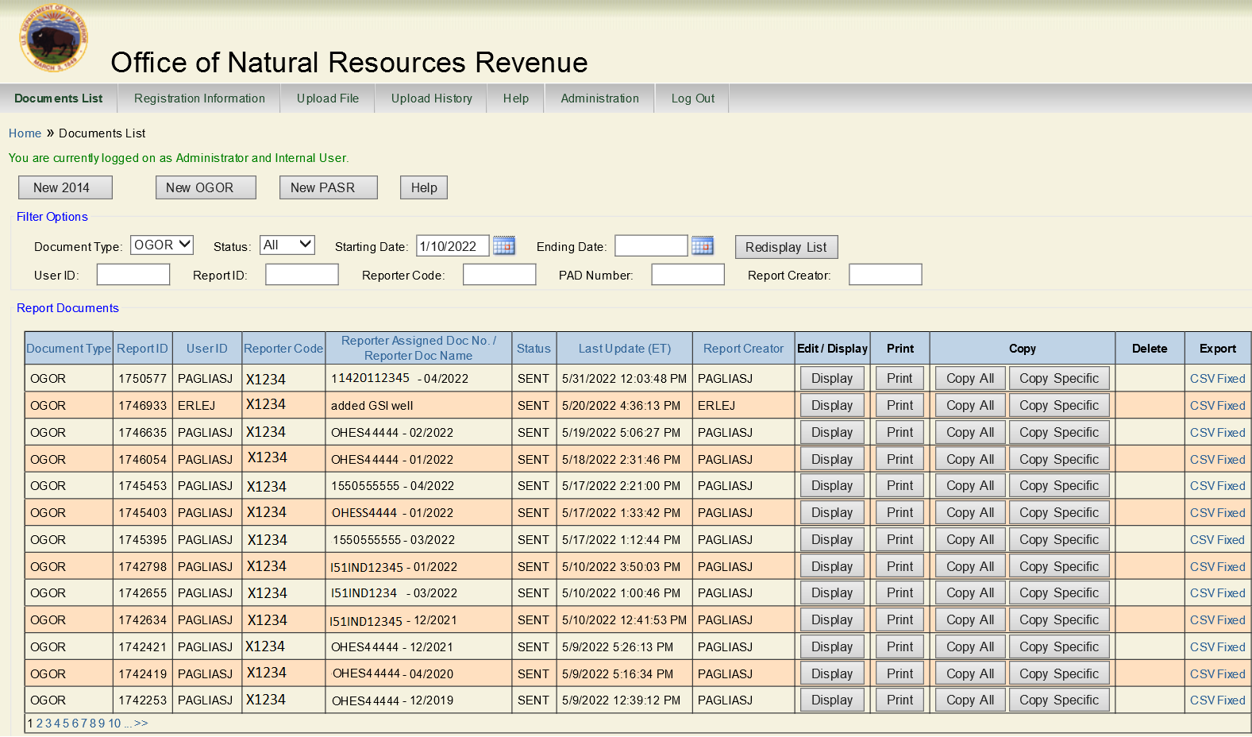
Documents List

Slide 7
OGOR Header
Report Type
Operator ID
MMS/Lease/Agreement Number
Agency/Lease/Agreement Number
Production month
Operator Assigned Doc Name

Slide 8
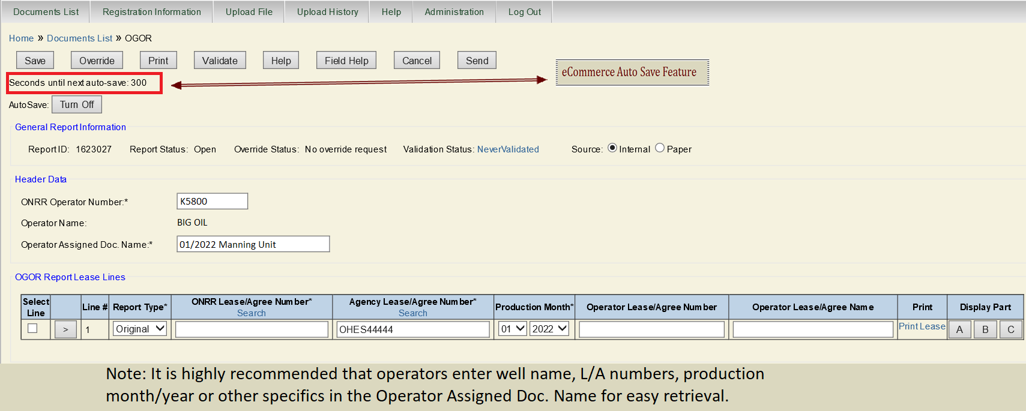
OGOR Header Details

Slide 9
OGOR-A
API well numbers
Well status codes and days produced or injected
Production and injection volumes

Slide 10
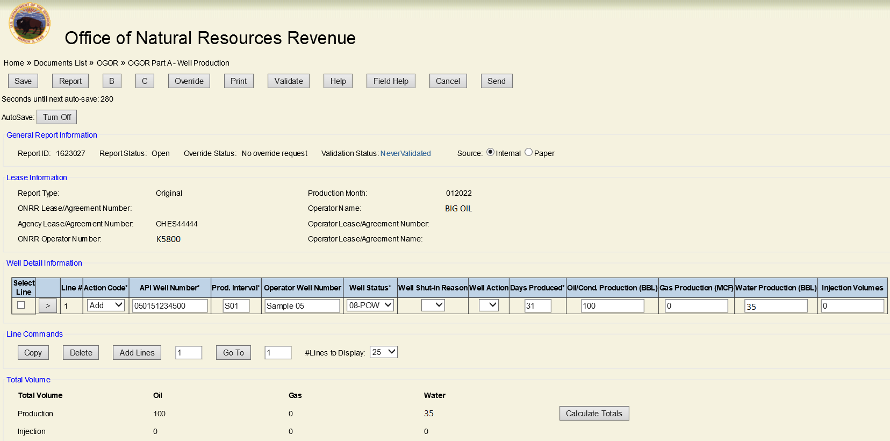
OGOR – A

Slide 11
OGOR-B
Disposition detail for produced volumes
FMP numbers are required for offshore
One product per disposition code per line
Produced volumes on OGOR-A must equal the sum of the OGOR-B disposition volumes

Slide 12
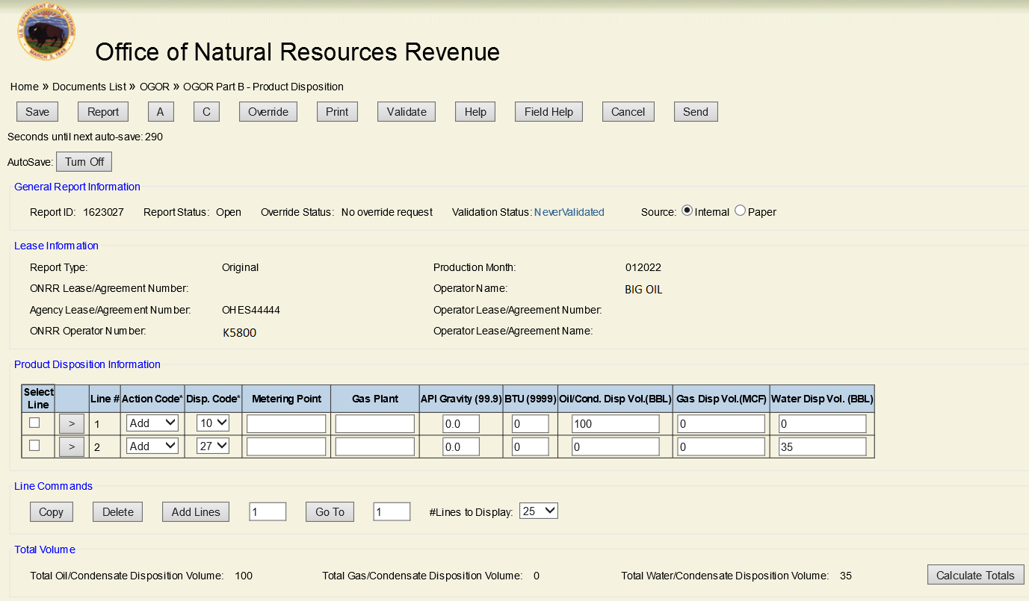
OGOR - B

Slide 13
OGOR-C
Used only for oil/condensate accounting when inventory is carried from month to month
Tracks running inventory storage (Reported inventories must match prior and subsequent months)
Beginning Inventory + Production – Sales +/- Adjustment Volume equals Ending Inventory
Production volume on OGOR-C must match Disposition code 10 volume on OGOR-B
FMP numbers are required for offshore

Slide 14
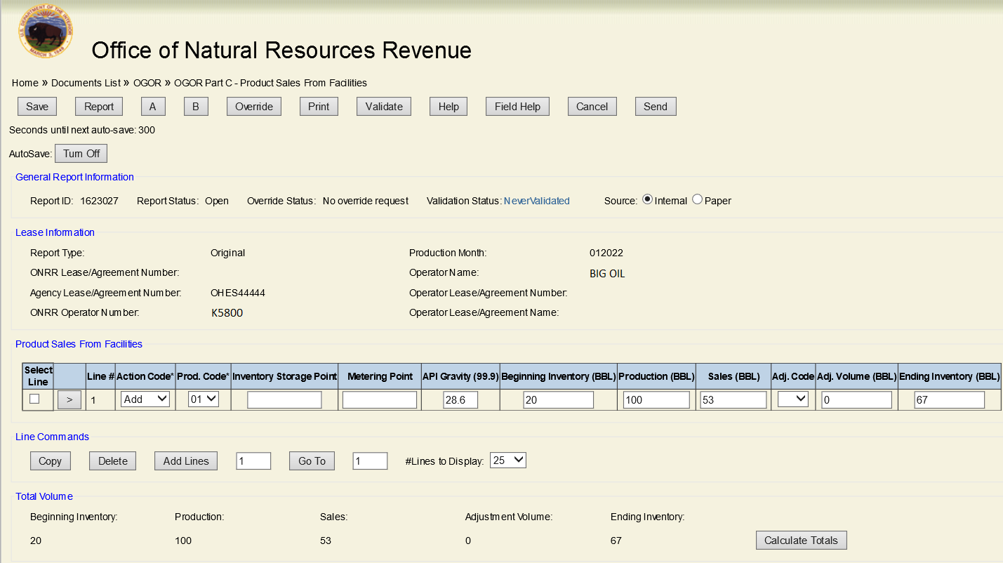
OGOR-C Details

Slide 15
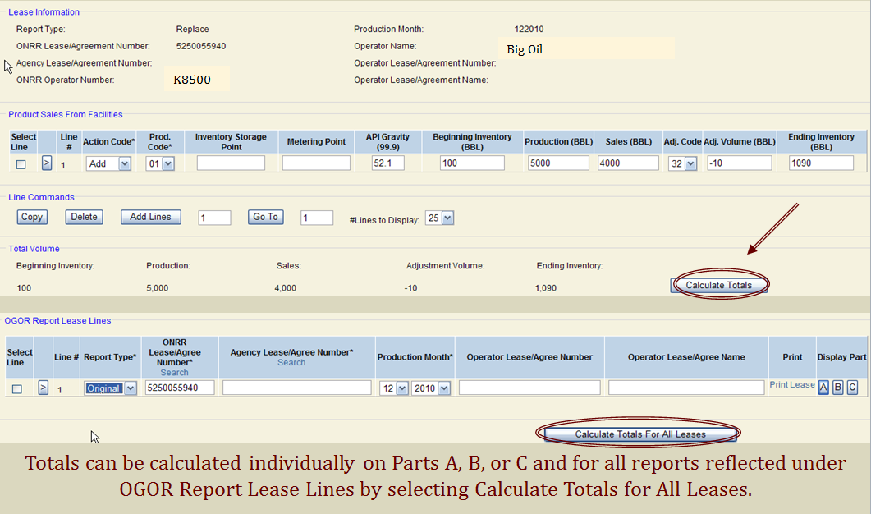
Calculating Totals

Slide 16
Validation
Ensure you save your document before validating
Required action prior to submitting OGOR
Pop-up window (ensure blockers are correctly configured)
Any Fatal and/or Warning error codes are listed in the validation results

Slide 17
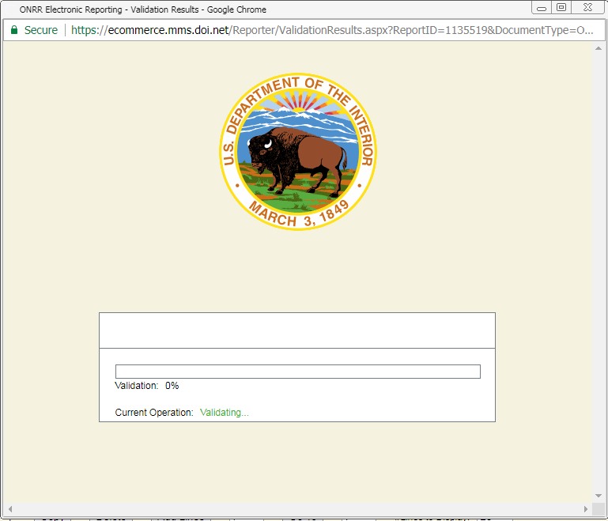
VALIDATION Image

Slide 18
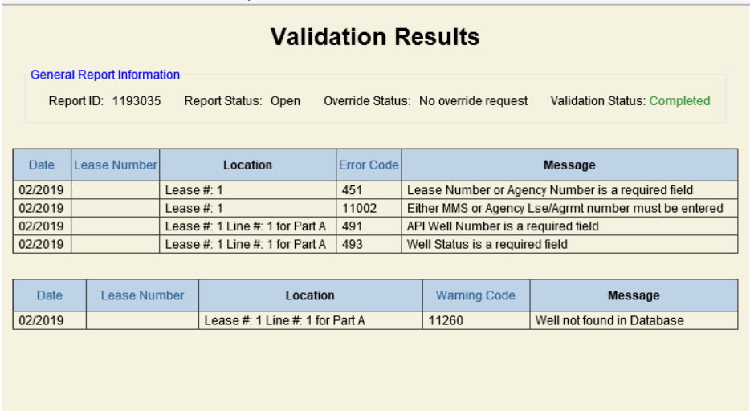
Validation Results

Slide 19
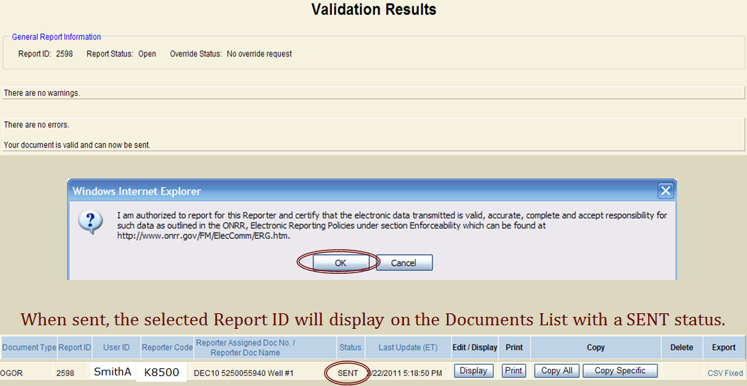
VALIDATION RESULTS Completed

Slide 20
eCommerce Document List Functions

Slide 21
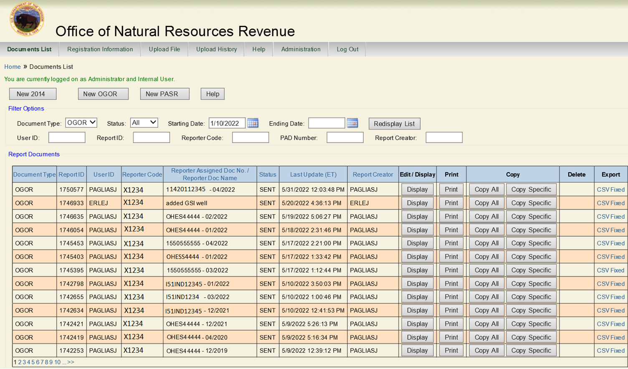
Documents List Sent

Slide 22
eCommerce Functions
Edit
Print
Copy All
Copy Specific
Delete
Export CSV- Fixed

Slide 23
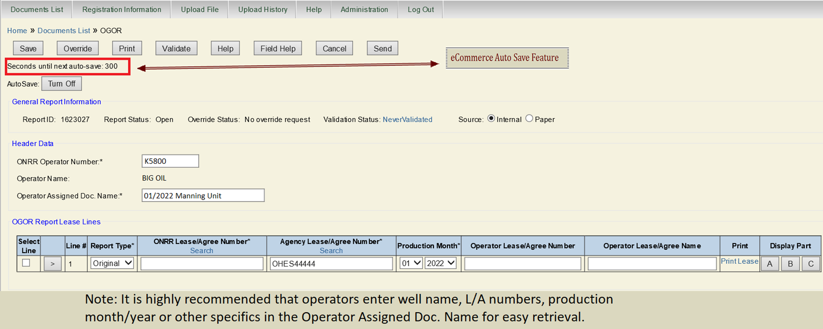
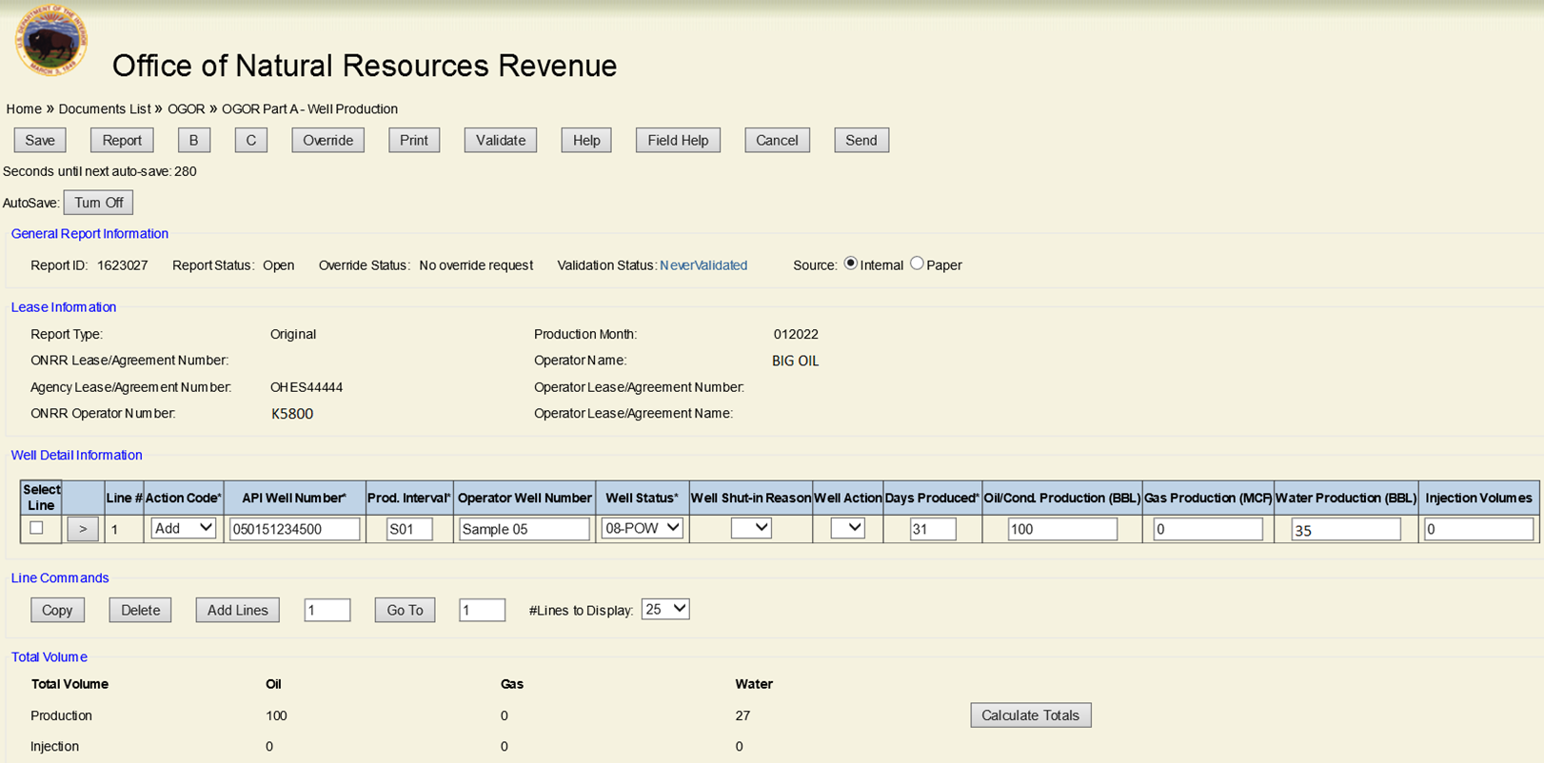
OVERRIDES
Each part of the OGOR has an override

Slide 24
OVERRIDE FUNCTION
Before requesting an override, contact your Production Reporting Contact
Acceptable errors for an override situation
are API Gravity and Btu content

Slide 25
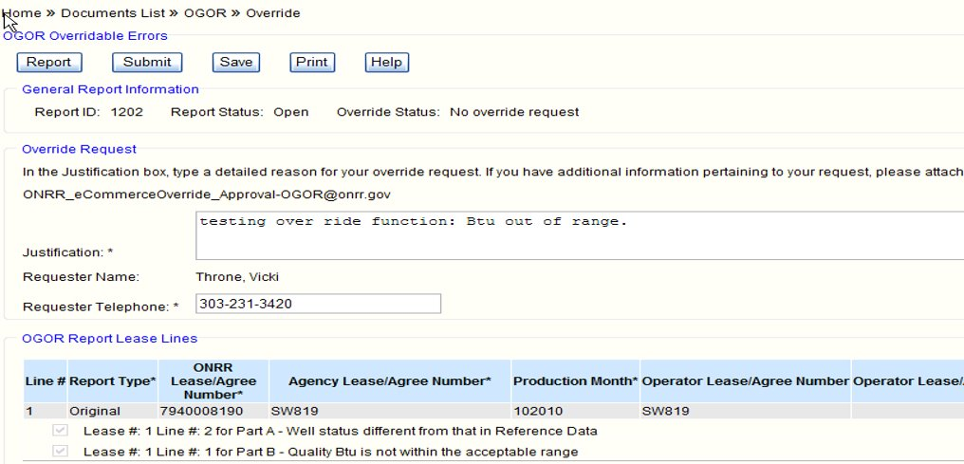
Override
Note: All Fields are required to process the override request

Slide 26
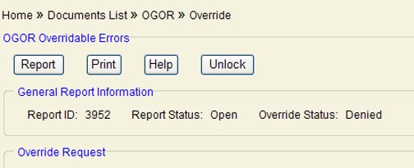
Override –email
If the override request is approved, then:
Click Report
Send
If the override request is denied, then:
Click Unlock
Fix Errors
Revalidate
Request a second override (if appropriate)
Send

Slide 27
Send OGOR

Slide 28
Thank you for attending the
Office of Natural Resources Revenue Reporter Training
For any questions regarding your OGOR reporting, please contact your ONRR Company contact
https://www.onrr.gov/about/contact.htm
Questions can be sent via email to reporter.training@onrr.gov

